Slide 1


Severe Injury in Construction Analysis
Yustika Itsnati Rahmah
linkedin.com/in/yustikaitsnati
medium.com/@yustikaitsnati
May 2023

Slide 2
TABLE OF CONTENTS
01
02
Background
Data Pre-Processing
03
04
Conclusions & Recommendations
Exploratory Data Analysis

Slide 3
Background
01

Slide 4
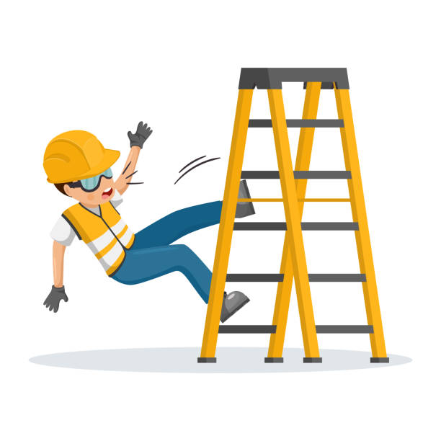
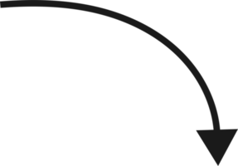
Background
Construction is a labor-intensive industry. Because of its complex activities, working in the construction industry is a high-risk job.
01
02
03
04
Construction is an industry with the second-highest number of work-related injury
5 of 10 most frequently violated OSHA standards in fiscal year 2021 is from construction industry
Construction has the highest number of fatality cases
Most work-related injuries are preventable
10%
Hospitalization
19%
Amputation
(Sources: MDNow, no date; BLS, 2020; OSHA, 2022)

Slide 5
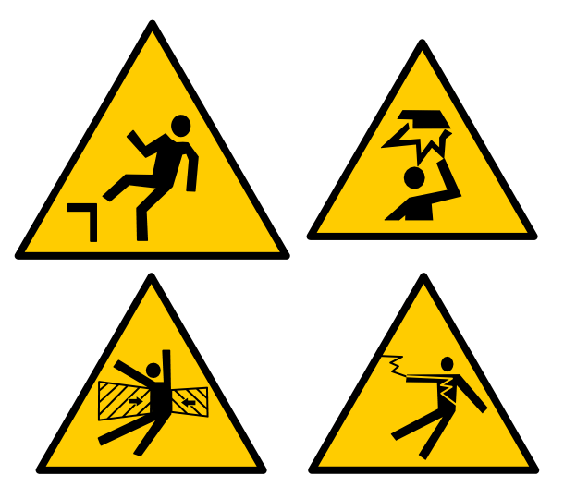
Construction Focus Four (OSHA)
Falls
Struck By
Electrocution
Caught
In-Between

Slide 6
$7.87 Billion
40%
What hazard/event we should more focusing on? What is the common source of those events?
The cost of workers’ compensation direct costs from the top five injury causes in construction in 2020
construction injuries result in days away from work
by answering these questions and taking the appropriate preventive measures, (hopefully) we can decrease the number above ☺
(Sources: Liberty Mutual Insurance, 2020; BLS, 2022)

Slide 7
Research Goals
Define the most common hazard and the most common event and source of the hazard
Giving recommendations to prevent them so the company can lower DAFW and costs

Slide 8
The data is from OSHA: https://www.osha.gov/severeinjury
OSHA requires employers to report all severe work-related injuries, defined as an amputation, in-patient hospitalization, or loss of an eye.
The data is from January 2015 to November 2022

Slide 9
02
Data Pre-Processing

Slide 10
Data Information
Before
After
74880
26
13374
8
Rows
Features
Rows
Features

Slide 11
Features
Injury Information
Company/Industry Information
EventDate
Hospitalized
Amputation
Inspection
Final Narrative
Nature
NatureTitle
BodyPart
BodyPartTitle
Event
EventTitle
Source
SourceTitle
SecondarySource
SecondarySourceTitle
ID
UPA
Employer
Address1
Address2
City
State
Zip
Latitude
Longitude
NAICS

Slide 12
Data Pre-Processing
Dropped 19 features and kept: ID, NAICS, EventDate,Hospitalized, Amputation, EventTitle, and SourceTitle for analysis
Dropped rows with NAICS started with other than ‘23 ‘ (Construction)
Dropped rows with missing value
Change EventDate data type to datetime
Change ‘Amputation’ = 0 to ‘No’ and ‘Amputation’ = 1 & 2 to ‘Yes’
Made a new column ‘HazardType’ to group the 'EventTitle' by its hazard type

Slide 13
03
Exploratory Data Analysis

Slide 14
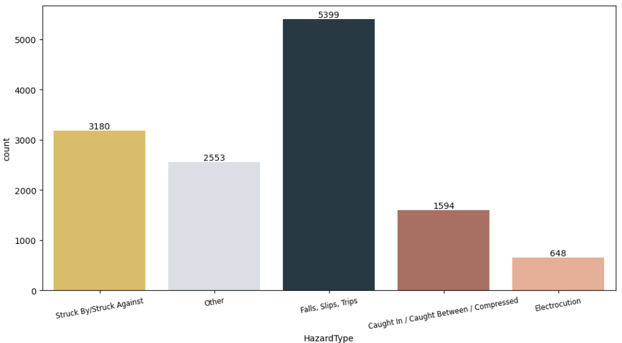
Falls, Slips, Trips is the major hazards in the construction industry
40%
Falls, slips, trips
24%
Struck by / Struck against
12%
Caught in-between / compressed

Slide 15
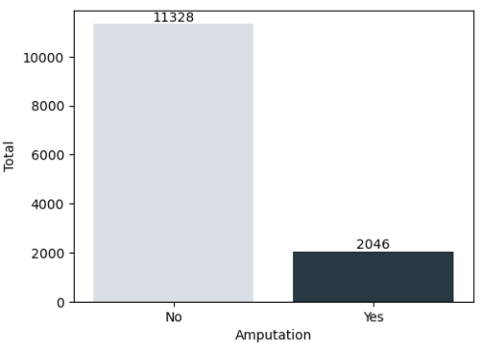
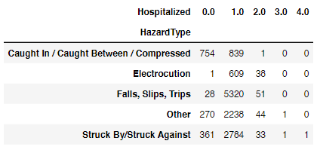
From 13,374 events, 88.2% of the events had 1 person hospitalized and 15.3% of the events had the worker(s) amputated
From 5399 cases of Falls Slips Trips, 5402 people were hospitalized. Struck by/against had 2 cases with more than 2 people injured.

Slide 16
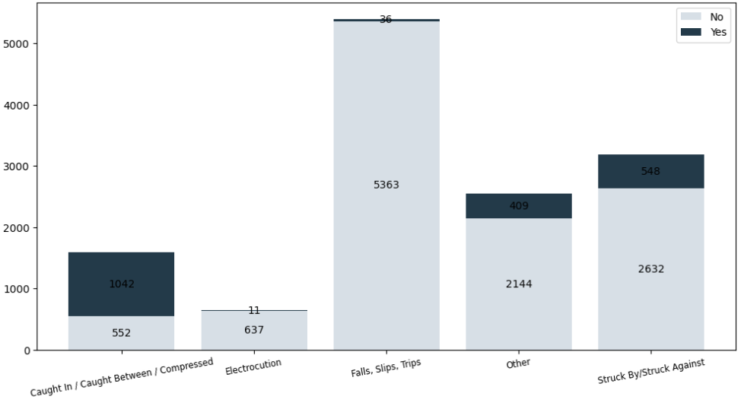
Caught in-between/compressed is the only hazard with the number of cases amputated more than 50% number of their cases.
Conversely, despite being the most common hazard, falls slips trips had only 36 cases amputated out of 5399 cases.

Slide 17
Falls, Slips, Trips
Based on the data, we know that falls slips trips is the most common hazard in the construction industry. Now let's check further about the details of falls slips trips hazard

Slide 18
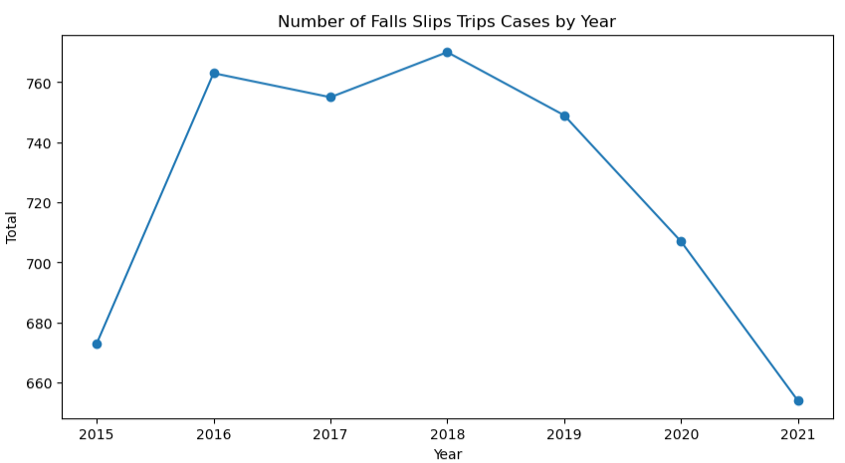
How is the trend of severe injuries cases caused by Falls, Slips, and Trips every year?
Proportion of Falls, Slips, Trips Cases each Year
Year | Total (%)
2015 | 39.26
2016 | 40.85
2017 | 40.55
2018 | 39.11
2019 | 38.29
2020 | 40.91
2021 | 42.83
decreasing
The number of Fall Slip Trip cases looks decreasing by 2019. This is probably because the number of severe injury cases since 2018 has started to fall, which is good, or the employers may not have reported the case(s), but the rate of falls slips trips cases in construction has remained at ~40%.

Slide 19
What event is the most likely to happen in falls slips trips accidents that cause severe injury?
Fall to lower levels is the main cause of severe injury related to falls slips trips. On the other hand, the fall on the same level is only 9% of the cases

Slide 20
Now we know 'fall to lower level' is the highest number of falls slips trips event that causes severe injury. What are the 5 main sources of the events?
From 4700 ‘fall to lower level’ events:
33%
17%
12%
ladders
roofs
scaffolding
or staging
7%
4%
existing openings
aerial lifts, elevators,
and hoists
Notes:
Ladders should only be used for quick tasks that can be completed with one hand while holding onto the ladder with the other. This is because ladders are primarily designed as means of access, not a working platform. Ladders are often misused in construction because the workers may have wanted to work quickly without thinking about the safety risk.

Slide 21
Conclusions & Recommendations
04

Slide 22
Conclusions
The most common hazard in construction is Falls, Slips, Trips hazard
The most common event related to falls, slips, trips is fall to lower level. We could say this is predictable because the activities and tasks in construction involve a lot of work at a height
3 top sources of fall to lower level are: ladders (33%), roofs (17%), and scaffolding/staging (12%)
The high number of falls, slips, trips cases also contribute greatly to the high costs incurred to compensate workers for hospitalization and amputations. Hospitalization and amputation also cause DAFW, thereby reducing the productivity of construction activities and can cause delays in the target

Slide 23
Recommendations
Plan the Job
Training
Improve Supervision
employers must plan projects to ensure that the job is done safely
every worker should be trained on proper set-up and safe use of equipment they use on the job.
employers have to make sure the job requiring ladders and any work in heights is well oversight by HSE Team
Decide how the job will be done
What task will be involved
What safety equipment may be needed

Slide 24
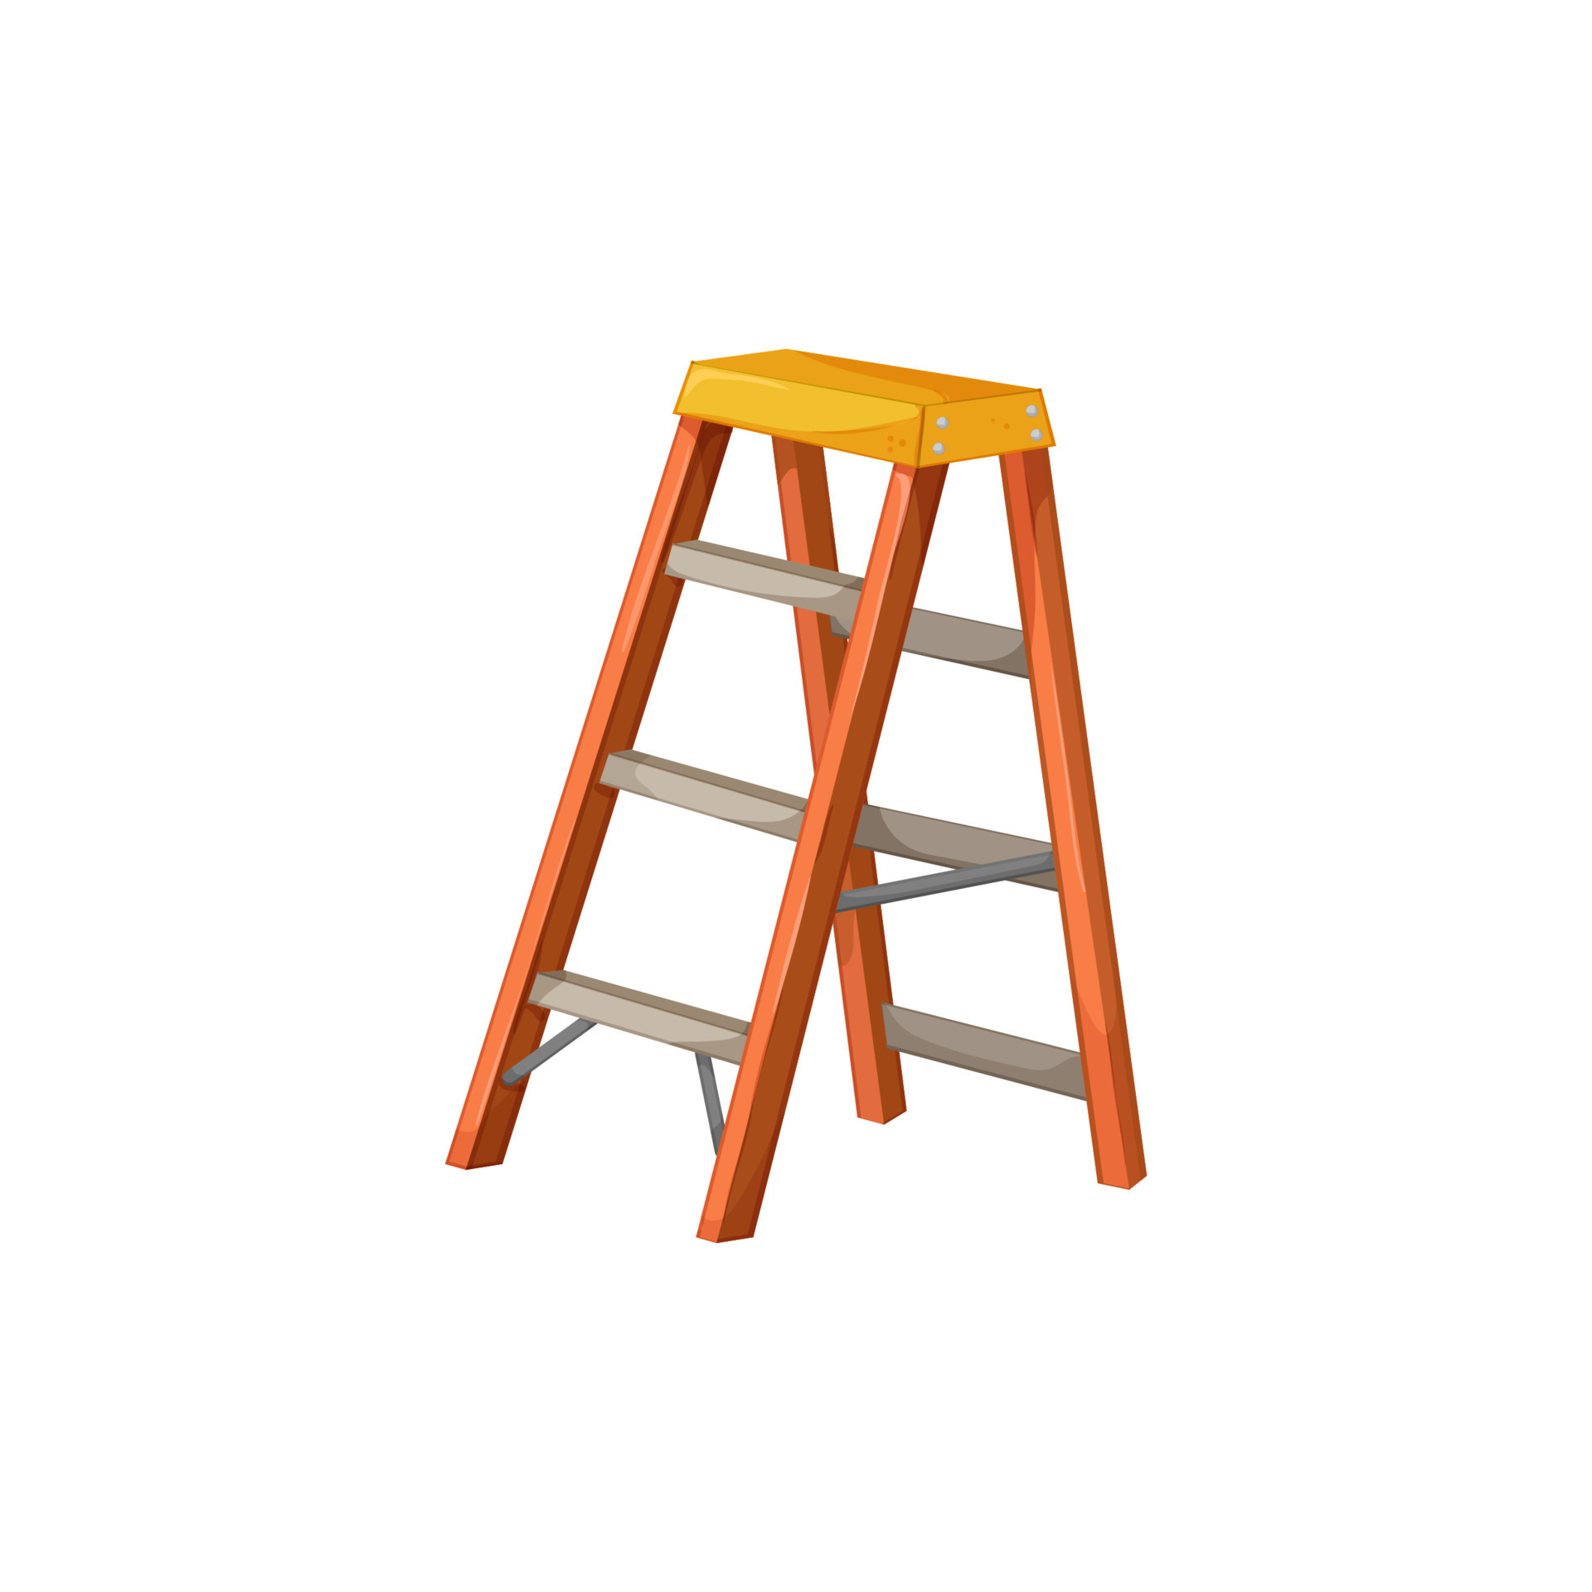
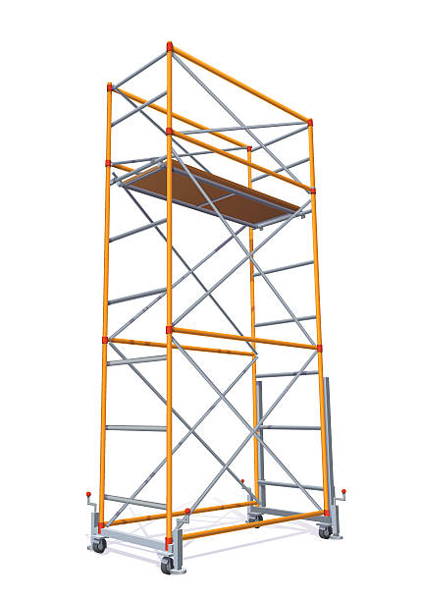
Recommendations
Equipments
PPE and Fall Protection
every tool and equipment should be inspected, regularly and before use
ladders, scaffolds, staging, etc should follow the applicable standard
always make sure the RIGHT PPE is provided in adequate amount and condition
fall protection must be provided by the employer and erected, maintained, and used with the correct procedure

Slide 25
References
BLS, Fatal occupational injuries by industry and event or exposure, all United States, 2020, 2021
BLS, Incidence rates of nonfatal occupational injuries and illnesses by industry and case types, 2021, 2021
Liberty Mutual Insurance, Workplace Safety Index 2020: Construction, 2020
MDNow Urgent Care, OSHA Warns That Manufacturing Employees Suffer the Most Work-Related Injuries
OSHA, Commonly Used Statistics
OSHA, Construction Focus Four Training
OSHA, Construction Focus Four: Fall Hazards, 2021
OSHA, OSHA's Fall Prevention Campaign
Some OSHA Standards:
OSHA, Duty to have fall protection
OSHA, Fall Protection Training
OSHA, Ladders
OSHA, General requirements - Scaffolds

Slide 26
THANKS!
For futher inquiries, please contact at:
yustikaitsnati@gmail.com
Please keep this slide for attribution

